Slide 1

Engineering AI Agency
Orchestrating Out-of-Distribution Capabilities through Custom Agent Harnesses for Production Systems

Slide 2
The Production Reality
Why off-the-shelf agents and pure LLM wrappers fail when moved from prototype to enterprise production environments.

Slide 3






Challenges of Agentic Development
Token Maxing
Memory Failures
Code Sprawl
Relying heavily on short-term conversational state by simply appending messages leads directly to context window exhaustion and massive latency spikes.
Failing to integrate structured state objects causes agents to suffer from the "lost in the middle" recall problem during long-running horizon tasks.
The sheer volume of AI-generated code requires automated CI gateways and deterministic rule-checking to prevent vulnerabilities from flooding production.

Slide 4
The Core Architectural Principle
Don't customize the model for what it already knows. Customize the harness for what the model cannot reliably know.
"
"
System Architecture Design Imperative

Slide 5


In-Distribution vs. Out-of-Distribution
•
In-Distribution (Model Harness): Capabilities the model inherently understands due to training. Keep these close to the model. Includes reasoning, code generation, natural language parsing, and standard patterns.
•
Out-of-Distribution (Custom Harness): Organization or domain-specific behaviors the model cannot guarantee. Must be encoded deterministically in the harness.
•
Explicit Rules: Enterprise policies, proprietary workflows, internal API structures, security boundaries, and approval processes belong strictly to the Custom Harness.
•
The Divide: This strict boundary separates the cognitive intelligence of the LLM from the controlled, safe execution environment.

Slide 6
Division of Responsibility
LLM Responsibility (Cognitive) | Harness Responsibility (Deterministic)
Understand intent and user goals | Enforce RBAC, Permissions, and Egress Policies
Reason through complex problem spaces | Manage State, Memory, and Transaction Logs
Plan task decomposition and DAGs | Enforce Schemas, Retries, and Bounded Loops
Choose appropriate capabilities/tools | Manage Resource Budgets and Sandbox Isolation
Generate alternatives and fuzzy judgments | Provide Checkpointing, Audit Logging, and Recovery

Slide 7


Agents SDK Runtime vs. Harness
1. Agents SDK Runtime
2. The Agent Harness
The runtime answers "Where does this agent live and how does it stay durable?"
The harness answers "What does this agent do on each turn?"
It provides the underlying resilient infrastructure. This includes the core Agent class, durable state management, session handling, fundamental routing, WebSockets, scheduling mechanisms, and basic observability metrics.
It dictates the actual behavior. This layer sits on top of the runtime and controls model calls, prompt construction, tool selection and interception, stream handling, advanced memory strategies, and lifecycle hooks (before/after agent execution).

Slide 8



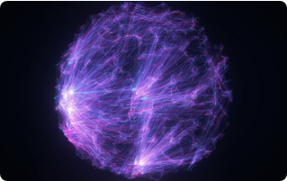
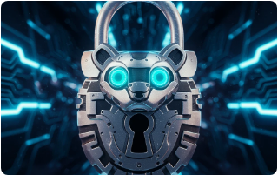
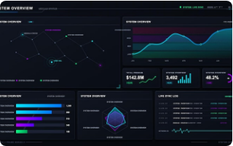
The Planes of Execution Orchestration
Context Plane
Policy Plane
Telemetry Plane
Manages progressive disclosure, memory summarization, and Retrieval-Augmented Generation (RAG) to prevent exhaustion.
Enforces granular security boundaries, executes unguided tasks in MicroVMs, and evaluates organizational rules.
Emits OpenTelemetry signals, traces prompt paths, manages cost budgets, and tracks immutable execution provenance.

Slide 9
Moving Up the Abstraction Layer
Don't just build the system. Build the system that builds the system.

Slide 10
The Path to System Factories
Level 2: Harness
Level 4: System Factory
Agents fortified with Skills, State tracking, Policy engines, and Orchestration loops.
Automated architectures that determine which systems to build for specific complex objectives.
Level 1: Agent
Level 3: Meta-Harness
The baseline setup combining a Model, basic Instructions, and raw Tool access.
Higher-level orchestration that dynamically constructs and configures specific Harnesses.

Slide 11

The Data Flywheel
Continuous Learning Loops
Teams often treat the LLM as a magic bullet rather than implementing continuous evaluation traces. A custom harness changes this dynamic.
By capturing telemetry on tool-call success rates, latency, and task completion, harnesses enable private evaluations and robust benchmarking.
This data feeds directly into fine-tuning Small Language Models (SLMs), creating a compounding value cycle that transforms fragile AI into durable, self-improving enterprise systems.

Slide 12
Questions?
Thank you for exploring the future of Agentic Architecture.

Slide 13





Image Sources
https://preview.redd.it/claudes-unprompted-self-portrait-run-the-same-prompt-and-v0-5iqqpvrajvyg1.png?width=640&crop=smart&auto=webp&s=ca4b975a798f1a188c7a24b81695974dabd3f474
Source: www.reddit.com
https://derivative.ca/sites/default/files/styles/content_colorbox/public/field/body-images/radial2.jpeg
Source: derivative.ca
https://media.craiyon.com/2025-08-18/9hVZF9DQSVGauFB6RgwSpw.webp
Source: www.craiyon.com
https://img.magnific.com/premium-vector/dashboard-displays-system-data-performance-metrics-analysis-tech-environment-scheduled-review_520737-17054.jpg?semt=ais_hybrid&w=740&q=80
Source: www.magnific.com
https://www.scienceabbey.com/wp-content/uploads/2025/06/the-science-of-energy.png
Source: www.scienceabbey.com

